Slide 1
Ontology Design #1
Air Pollution
Presented by
Ms. Pattama Krataithong (120577)
Ms. Nuchjanee Intarat (120546) Ms. Gayatri T (119978)

Slide 2
Outline
Air Pollution in The Cities
Competency Questions
Application
Air Pollution Ontology
Data
Air Quality Index

Slide 3
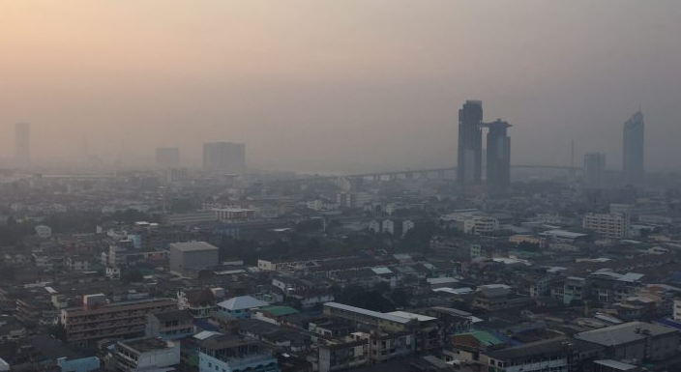
Air Pollution in Cities
why do we have to care about it?
https://news.mthai.com/app/uploads/2019/01/S__226353168-780x405.jpg.

Slide 4
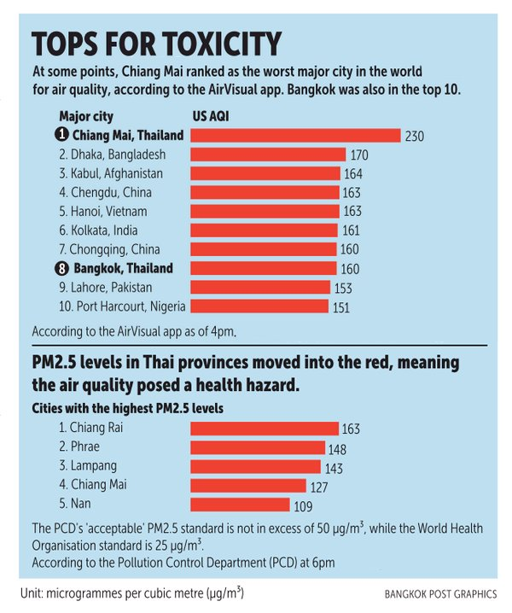
Current situation
Updated: 12, Mar 2019
https://www.bangkokpost.com/learning/easy/1643832/chiang-mai-air-pollution-worst-in-the-world?fbclid=IwAR22ERqwdFohFeoFBC1eBRfAeqscxhBIA9oVzxKh4UhQd4iZfeFModHd1pE

Slide 5
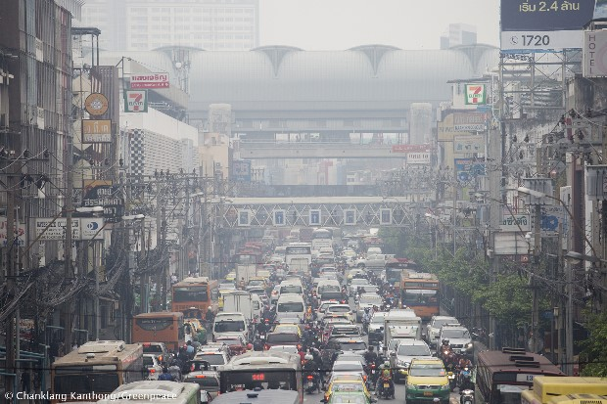
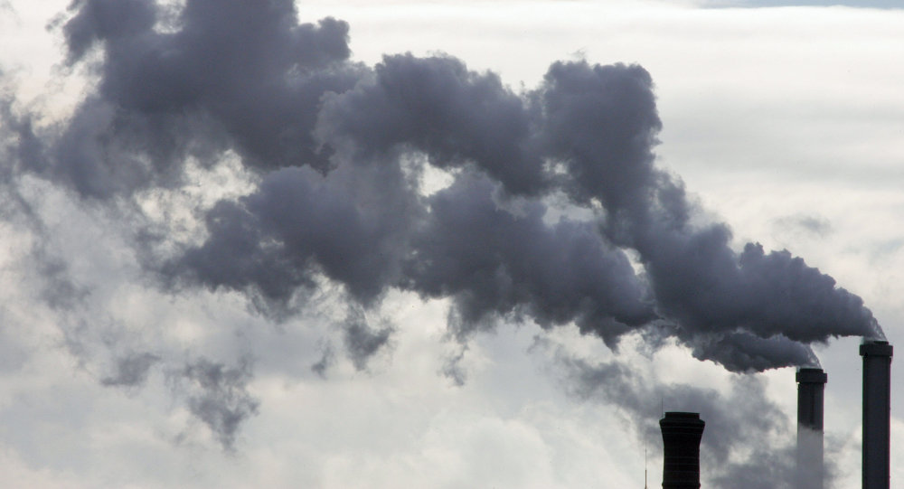
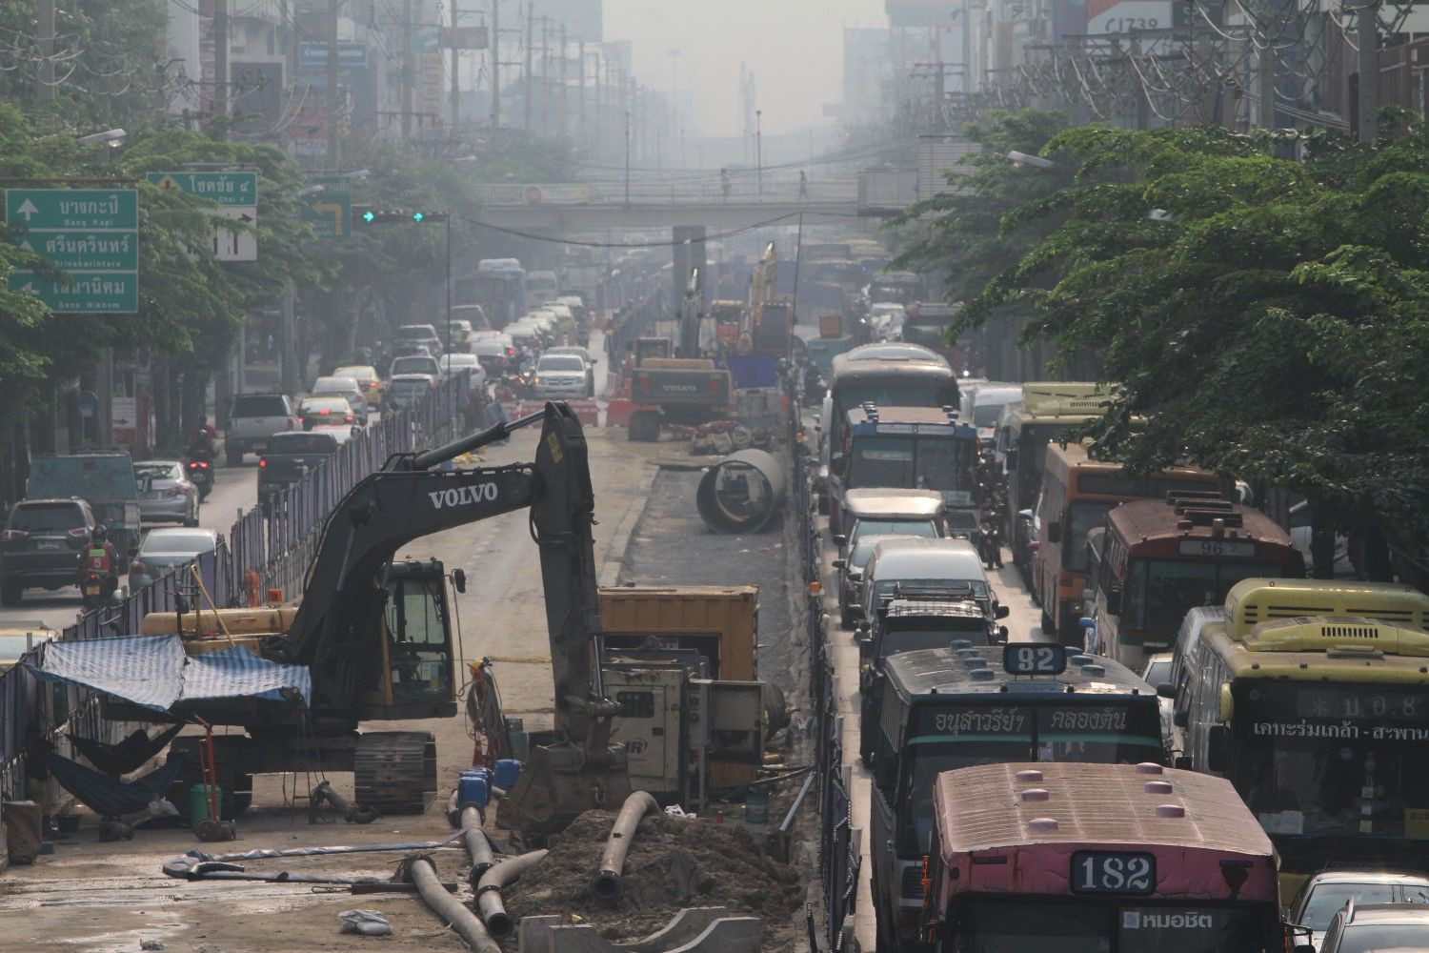
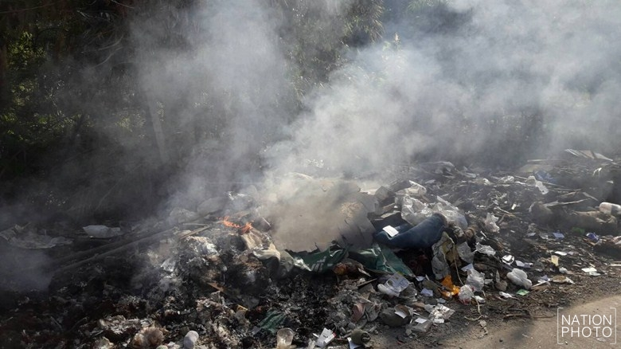
Main Causes of Air Pollution
60%
5%
35%
https://news.mthai.com/general-news/700924.html
Notes:
60% - traffic 35% - burning outdoor
5% - factory and construction

Slide 6

How can we solve this problem?
Awareness among citizens and their Participation
Reduce car usage
Use public transport
Avoid burning garbage
Monitor fire in the city: farm, forest fire
Government needs Information Support
Instantly action
Consider new policy

Slide 7
How can our application contribute to the solution?

Slide 8
Competency Questions (CQs)
Group | CQs
Air Quality | 1. How was the air pollution at AIT last week? PM2.5 PM10 2. Is the air quality better than last month in AIT? 3. What are the top five areas in Pathumthani which have high risk of air pollution?
Monitoring | 4. How many are there sensors in Pathumthani? 5. Where is the closest sensor near me?

Slide 9
Competency Questions (CQs)
Group | CQs
Cause | 6. What top five causes of air pollution at Khlong Luang, Pathumthani?
Solution | 7. What are the areas in Pathumthani that have achieved more than 50 of pm 2.5 decrease and the solutions they have used?

Slide 10
Competency Questions (CQs)
Group | CQs
Protection | 8. What are the recommended solutions for cause of pollution in a particular area? 9. When people should wear mask? - Alert warning message when the air quality is bad 10. What should I do when visit a polluted area?
Notes:
Summarize from causes of each area and conclusion the general suggestions guideline
Should not burn garbage
Use of public transportation

Slide 11
Application
Monitor air pollution by location
Keep updated about pollution levels
Alert / warning / notification when air pollution greater than the standard value
Give suggestion for people and sensitive groups to prevent health hazards
Social media application
Citizen : reporting when have burning or fire at somewhere (cause of air pollution)
Authorities : reporting an action when they address the problem
Notes:
//backup : Social media application for alert / warning / notification when have burning or fire at somewhere.
//Cool natural language querying for all that you want to know about air pollution around you. (similar 1st function)

Slide 12
Air Pollution Ontology 1/2
Propose the useful air pollution ontology to monitoring and control air pollution in the urban
Citizens/People
Authorities
Monitor Air Quality
Take an action to solve the problem
Report the Cause of Air pollution
Make a better planning and law enforcement
Get the suggestions for prevent health hazards
Notes:
What will they use it for?

Slide 13
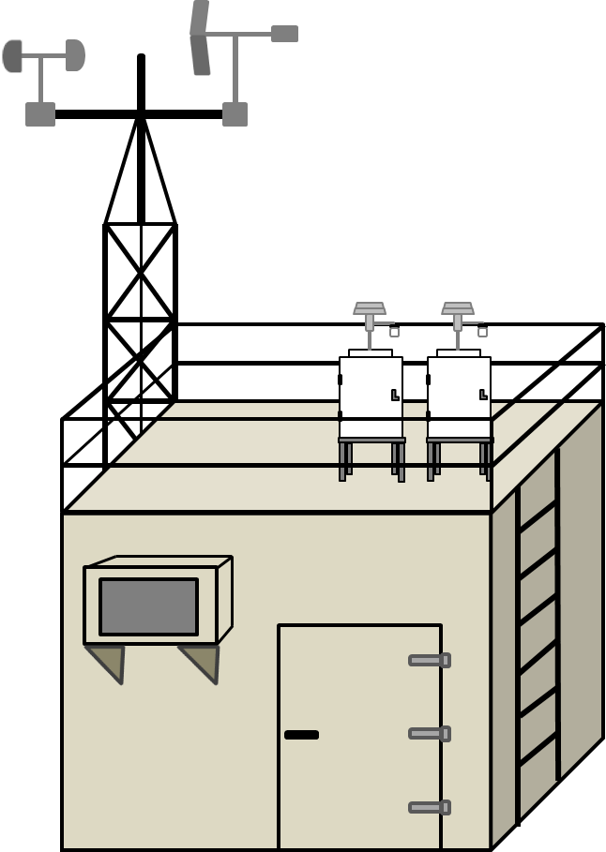


Air Pollution Ontology 2/2
Leverage the data which generated in the city such as physical device, and human for monitoring air pollution and make it available to everyone.
Air Quality Monitoring Station
Geographical Data
Social Network

Slide 14
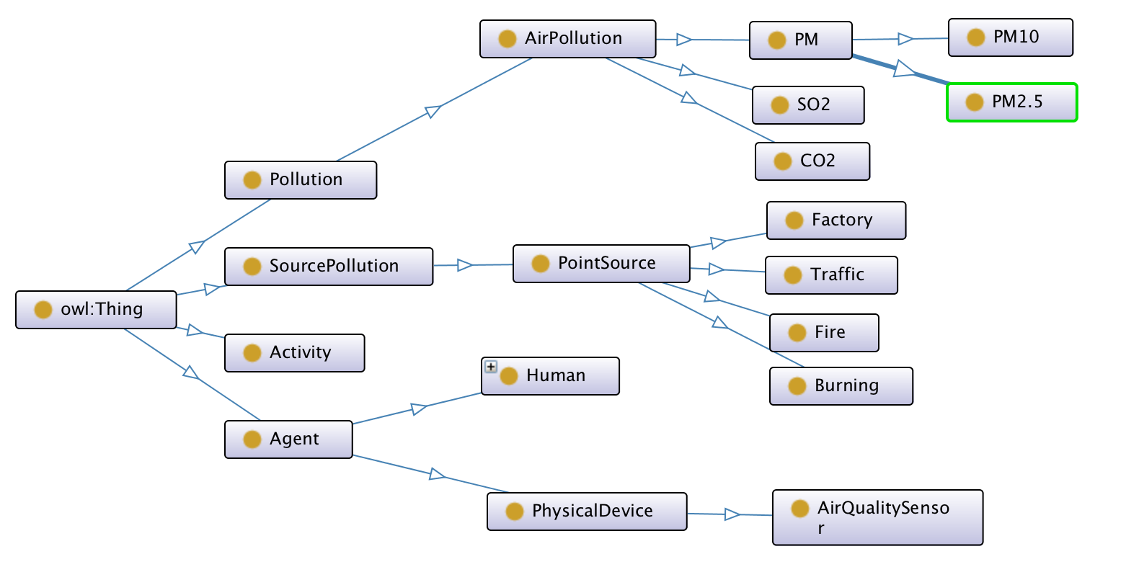
Air Pollution Ontology (Draf Version.)
Source: AIR_POLLUTION_Onto (http://dl.ifip.org/db/conf/ifip12/aiai2009/Oprea09.pdf)
Notes:
What is the different between ontology and traditional database?
Activity - Attempt, Solution, Protection
ap:causeOf

Slide 15
Data
Static Data | Dynamic Data
Geographical Data | Air Quality Value - CO2, CO, NO2 , PM10, PM2.5 and SO2
Air Quality Monitoring Station | Social Network: - report cause of air pollution such as burning farm at somewhere - report activities from authorities such as extinguish a fire at somewhere by organization/someone
User information
Suggestions how to prepare myself when face air pollution

Slide 16
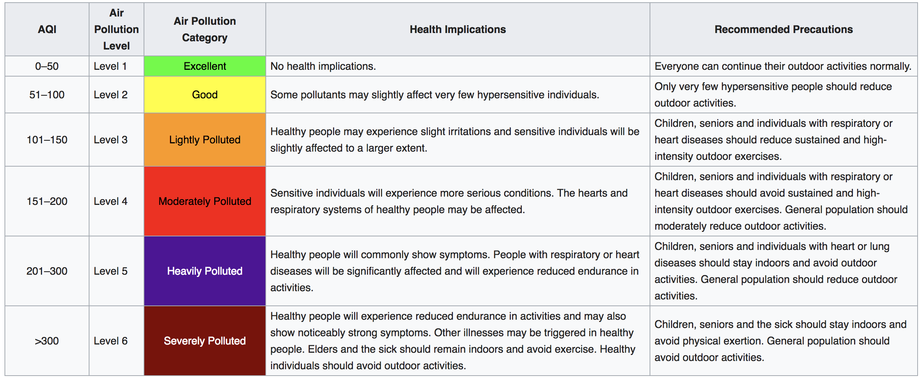
Air Quality Index
https://en.wikipedia.org/wiki/Air_quality_index
Notes:
Air Quality Index
given by WHO
(according to US air pollution safety levels)

Slide 17
References
AIR_POLLUTION_Onto (http://dl.ifip.org/db/conf/ifip12/aiai2009/Oprea09.pdf)
Margan, B., Hakimpour, F., & Saber, M. (2018). Linked data geo-statistical analysis of air pollution in urban areas. 2018 4th International Conference on Web Research (ICWR). doi:10.1109/icwr.2018.8387242
https://en.wikipedia.org/wiki/Air_quality_index

Slide 18
Thank You

Slide 19
Outline
To begin, you will want to specify your ontology's
domain precisely. For example,
– Who will be using your ontology? done
– What will they use it for? done
– What sorts of relationships will they want to know about? CQ Done
– Be creative and specific. Creative? How? The topic we choose is already creative and specific :) sure
• Prepare a set of at least 10 competency questions Done
that your ontology should be able to answer.
• These questions should provide a picture of the Done
breadth of your ontologaey's scope.

Slide 20
Proposed Solution 1/2
People become aware of air pollution levels in real time.
Sensitive groups can take precautions to prevent health hazards.
Public authorities can use the information for better planning and law enforcement.
People in the city try to solve air pollution together.
Application for monitor and report the situation of air quality in the city => public authority use data for protection and planning
Notes:
What will they use it for?

Slide 21
Target Groups
Citizens/People
Public Authorities
Law making bodies
Notes:
Who will be using your ontology?

Slide 22
Competency Question
How was the air pollution at AIT last week?
How many sensors in Pathumthani?
Where is the closest sensor to me?
What top five causes of air pollution at Khlong Luang,Pathumthani?
What top five areas in Pathumthani which have high risk of air pollution?
What are the areas in Pathumthani that have achieved more than 50 pm 2.5 decrease and the solutions they have used.
Is the air quality better than last month in AIT?
Notes:
What sorts of relationships will they want to know about?

Slide 23
Competency Question
8. What are the recommended solutions for cause of pollution in a particular area?
9. When people should wear mask? - Alert warning message when the air quality is bad
10. What should I do when visit a polluted area?
Notes:
//backup:10Suggestion for preparing sensitive groups to visit a polluted area (change to question?)

